Slide 1
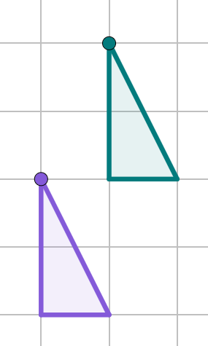
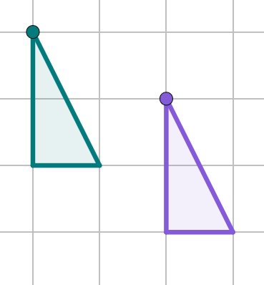
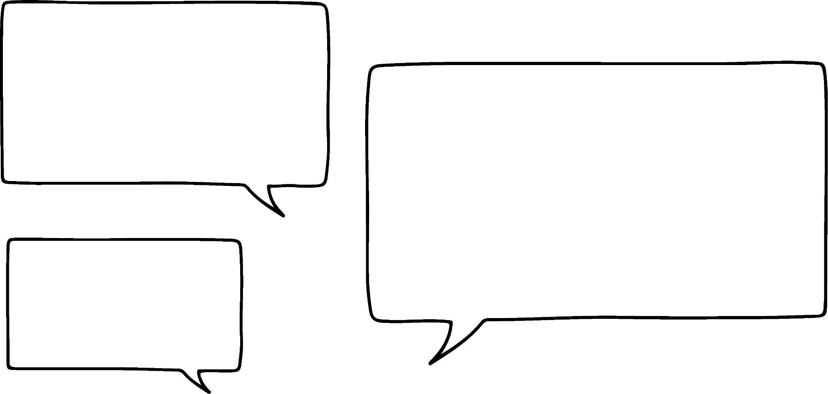

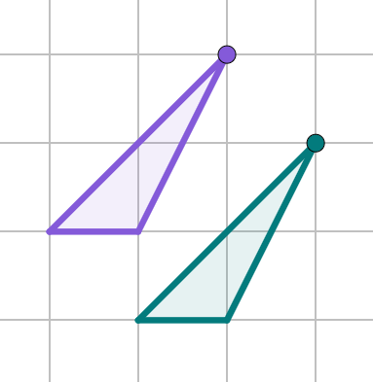
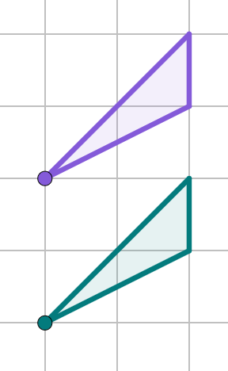
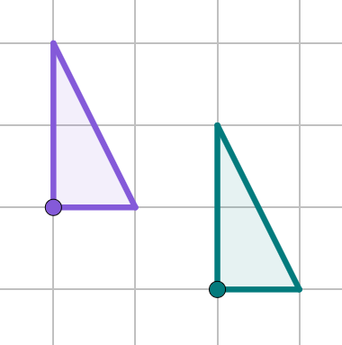
Describing a translation
Task A: Describing a translation
1) Complete the description for each image.
a)
A′
b)
A′
A
A
The object has been translated . right by 1 squares and . up by 2 squares.
The object has been translated . left by 2 squares and . up by 1 squares.
2) Izzy has given an incomplete description of a translation.
Write a full description for the translation shown.
The shape has moved across and down.
P
P′
The object has been translated right by 1 square and down by 1 square.
Write full descriptions for the translations.
a)
b)
T′
T
R
R′
The object has been translated right by 2 squares and down by 1 square.
The object has been translated left by 2 squares.

Slide 2


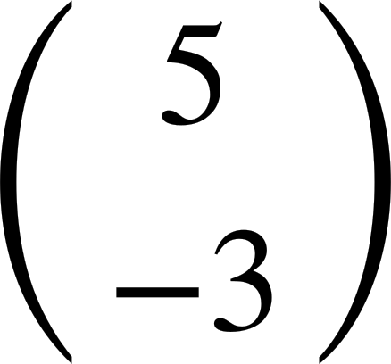
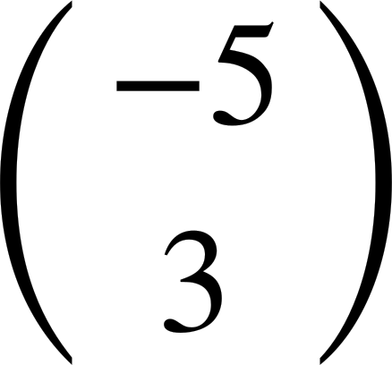
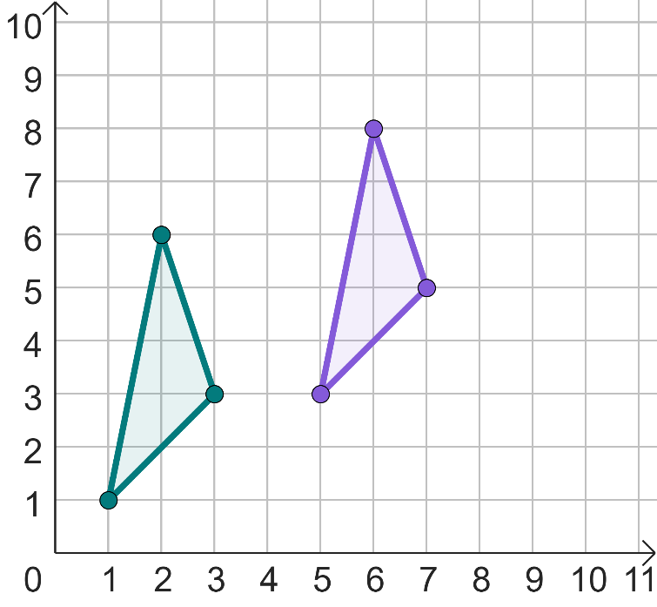
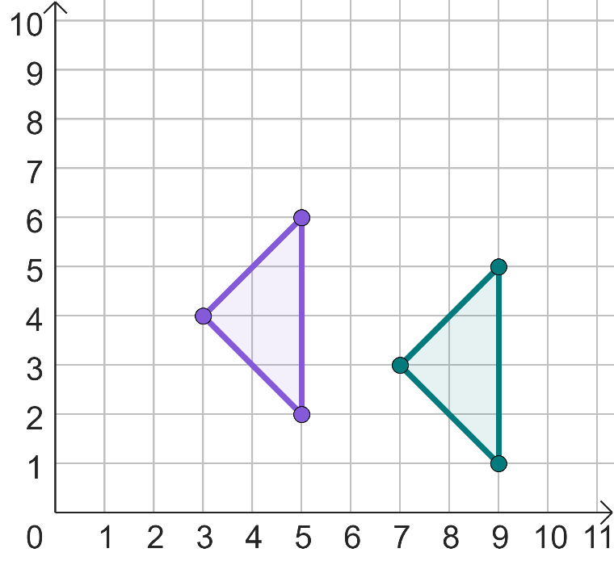
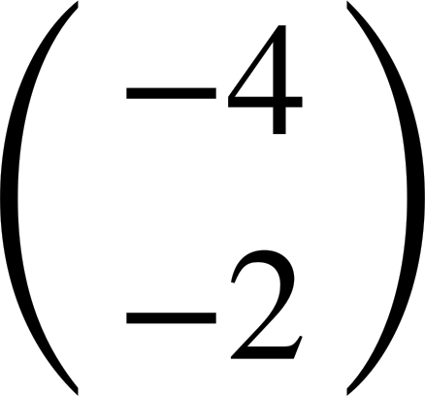
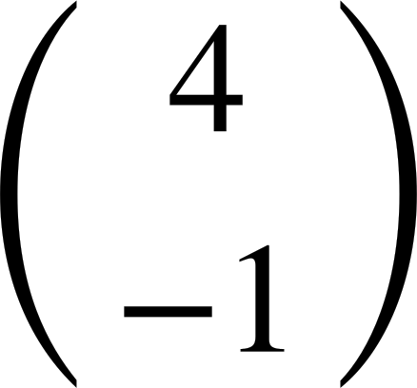
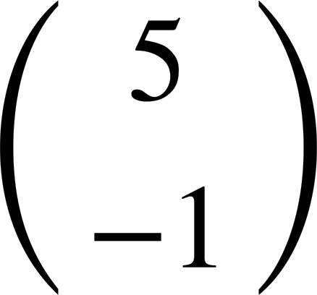
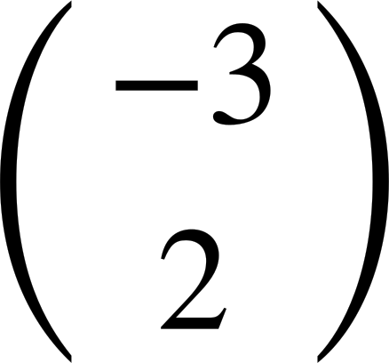
Describing a translation
Task B: Vector notation
Match the description to the column vector.
Translated left by 5 and up by 3 units.
Translated right by 3 and up by 5 units.
Translated right by 5 and up by 3 units.
Translated right by 5 and down by 3 units.
Write a description using a column vector for each translation.
a)
I
b)
I′
J
J′
Translated by
Translated by
3) Given the coordinates of the object and image, describe the translation.
a)
Object coordinate
Image coordinate
b)
Object coordinate
Image coordinate
(-2, 2)
(3, 1)
(2, 6)
(-1, 8)
(-2, -2)
(3, -3)
(4, 3)
(1, 5)
(1, -2)
(6, -3)
(5, 6)
(2, 8)
Translated by
Translated by
Mathematics in Education and Industry.
v2.2

